Slide 1
3D Face Rectification Stereo Project
Computer vision

Slide 2
Introduction
2
Reconstruct a 3D scene/object from images observed from multiple view points by camera calibration, correspondence of tokens, and 3D reconstruction from rectified images.
Extracted 3D information of a human face from 2 images taken from different views, established no co-planar, matched facial landmarks using the 8-point method and produced the images using the rectification procedure.

Slide 3
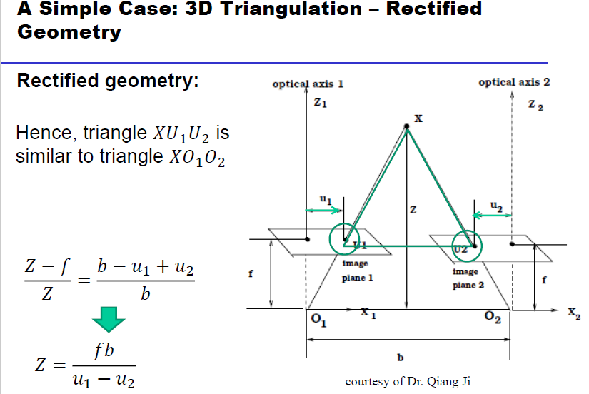
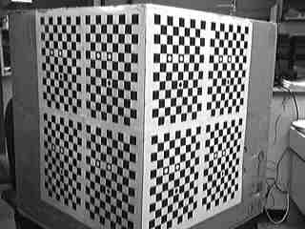
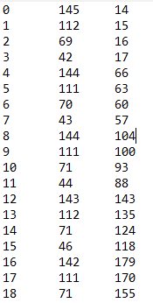
Methodologies
4

Slide 4
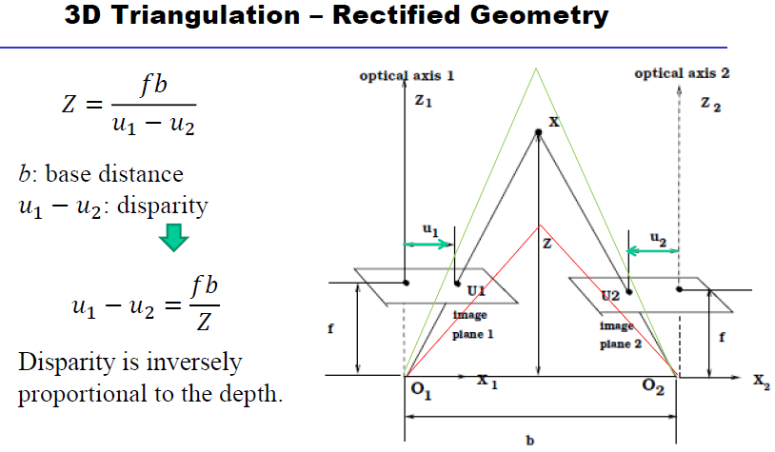
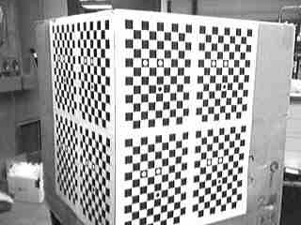
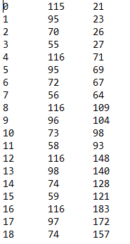
Methodologies
5

Slide 5
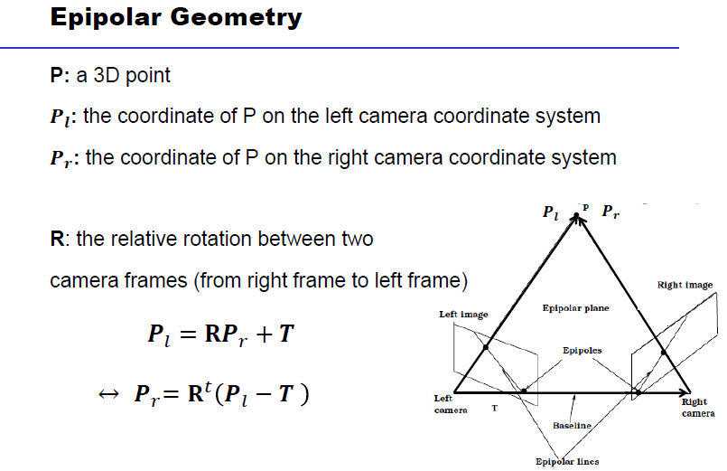
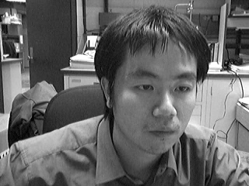
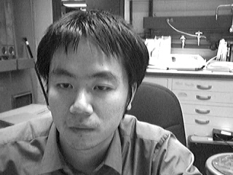
Evaluation
9

Slide 6
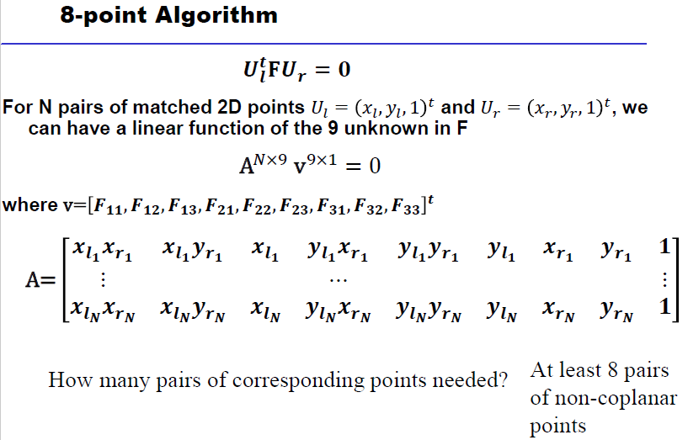
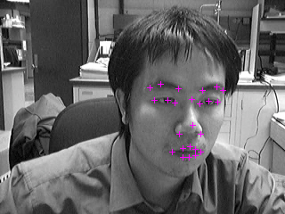
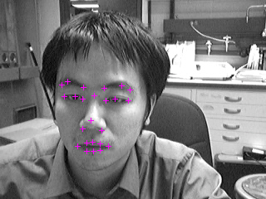
Deep Learning Segmentation
10

Slide 7
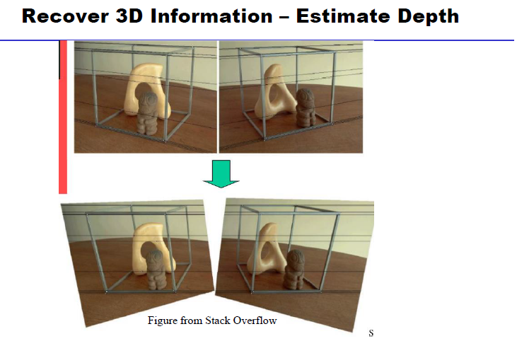
Rectification
11

Slide 8
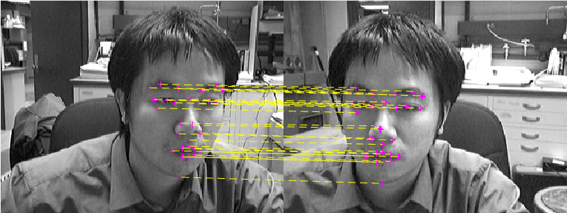
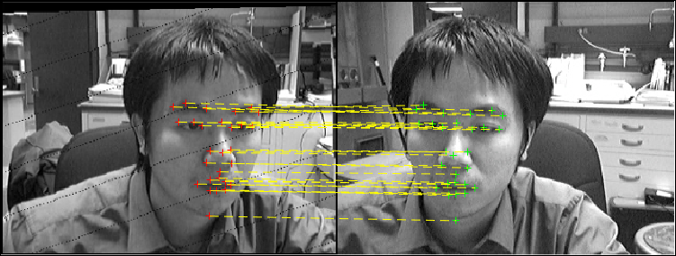
Results
13

Slide 9
Issues
12
The displacement of reprojected image range. Solution: Post processing ( rescaling and translating)
Missing points in forward mapping. Solution: Backward mapping.
The non-integer rectified coordinates. Solution: Bilinear interpolation.

Slide 10
Conclusion
15
Image rectification is a transformation process used to project images onto a common image plane. It is used in computer stereo vision to simplify the problem of finding matching points between images (i.e. the correspondence problem).

Slide 11
Thank You

